Slide 1
Car Price Prediction
UE20CS302 – Machine Intelligence
Mini Project
Project Title: Car Price Prediction
Team No: 23
Project Guide: Dr . Gokul Kannan Sadasivam
Project Team with SRNs: MEGHANA N– PES2UG20CS519
SUSHMITHA– PES2UG20CS472

Slide 2
Problem Statement
The focus of this project is developing a machine learning model using python that can accurately predict the price of used car based on the dataset features like brand, year, sold price, present price, KMS driven, fuel type, transmission type and owners, in order to make informed purchases. This project is built on Linear and Lasso Regression model.
Notes:
Provide a basic introduction of the project and also an overview of scope it entails.
Set the context.

Slide 3
Application and Uses
-> Can cope up with price volatility
-> Can analyze multiple sources at a time
-> Improves the accuracy of price predictions
-> Improves profit margin
-> Industrial sectors like retail, marketing, automotive and stock picking benefit the most.
Notes:
Provide a basic introduction of the project and also an overview of scope it entails.
Set the context.

Slide 4
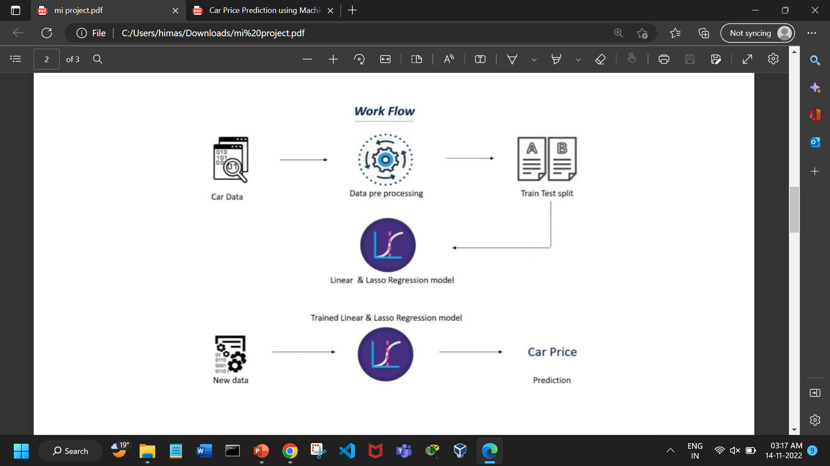
High level Architecture
The data is pre-processed after it is collected. Once the data is processed it is split into training data and test data (Train test split). This is then fed into Linear and Lasso Regression model to compare the error percentage or the accuracy score. After this we have Trained Linear and Lasso Regression model to which the new data can be fed and the car price can be predicted.

Slide 5
Title of the paper | Year of Publication | Journal/Conference Name | Advantages | Limitations
Car Price Prediction | 2019 | TEM Journal | PHP scripts were built to normalize, standardize and clean data to avoid unnecessary noise for ML algorithms. | It consumes much more computational resources than single ML algorithm.
Car Price Prediction | 2019 | International Journal of Engineering and Advanced Technology (IJEAT) | Use of three different prediction models to predict the retail priced of a used car and compare their levels of accuracy. | The mean error of the regression tree model is more than the error rate of the of the multiple and lasso regression models.
Car Price Prediction | 2021 | International research journal of modernization in engineering technology and science | Comparing the prediction accuracy of linear-regression, KNN, Random forest, XG boost and decision tree models to determine the optimal one | Less number of records of old cars.

Slide 6
Title of the paper | Year of Publication | Journal/Conference Name | Advantages | Limitations
Car Price Prediction | 2014 | Journal of Emerging Technologies and Innovative Research (JETIR) | They’ve compared some algorithms for prognosticating auto buying purposes which gives better delicacy. | Gradient boosting algorithm is used which scarifies intelligibility and interpretability. Low number of records have been used.
Car Price Prediction | 2013 | Ijraset journal for research in applied science and engineering | Random forest and Extra tree regression methodologies have been used which are amazingly precise and quick irrespective of the size if the dataset. | Information related to past vehicle cost is not used which helps the AI model to increment its precision.
Car Price Prediction | 2020 | International Journal of Innovative research in Applied Sciences and Engineering (IJIRASE) | KNN algorithm and K-fold methods are used which are simple and suitable for small data and easy to understand and implement. | The proposed model gets the best results only after cross validation.

Slide 7
Proposed Approach This project uses train and test model to split the selected data base into train and test data to estimate the performance. Further by using test set we determine if the model is underfitting or overfitting the data. After this the split data is fed into Linear and Lasso regression model to compare the error percentage or the accuracy score. Now we have trained linear and Lasso regression model to which the new data can be fed and the car price can be predicted.

Slide 8
Results and Discussion
Using Train test split and Linear and lasso models, this project proposed a scalable framework for used cars price prediction. Dataset is collected from Kaggle website. This was performed in real-time within the Google Colab environment using Python language (Libraries used: Pandas, Matplotlib and Seaborn). In comparison to the system’s integrated Jupyter notebook and Anaconda’s platform, algorithms took less training time in Google Colab.

Slide 9
Refrences
Enis Gegic, Becir Isakovic, Dino Keco, Zerina Masetic, Jasmin Kevric International Burch University, Sarajevo, Bosnia and Herzegovina. TEM Journal. Volume 8, Issue 1, Pages 113- 118, ISSN 2217-8309, DOI: 10.18421/TEM81-16, February 2019.
International Journal of Engineering and Advanced Technology (IJEAT) ISSN: 2249 – 8958, Volume-9 Issue-1S3, December 2019, Pattabiraman Venkatasubbu, Mukkesh Ganesh
e-ISSN: 2582-5208 International Research Journal of Modernization in Engineering Technology and Science Volume:03/Issue:03/March-2021 Impact Factor- 5.354
Journal of Emerging Technologies and Innovative Research (JETIR) ISSN: 2349-5162, ESTD Year: 2014, JETIR April 2022, Volume 9, Issue 4 Mrs. T Veda Reddy, Y Praneeth, Y Sai Kiran, G Sai Pavan
Ijraset Journal for Research in Applied Science and Engineering Technology, ISSN: 2321- 9653, ESTD:2013, Paper Id : IJRASET44225, Publish Date : 2022-06-13, Rithvik Raj Mekala, Gouru Laxmi Sevitha, Tushar Anumula, Kusuma Latha
International Journal of Innovative Research in Applied Sciences and Engineering (IJIRASE) Volume 4, Issue 2, DOI: 10.29027/IJIRASE.v4.i2.2020.629-320
https://www.kaggle.com/datasets/nehalbirla/vehicle-dataset-from-cardekho

Slide 10
Thank You

